Slide 1
Shape from X
Computer vision
Guided by: Dr. Sabri
Presentor: Heydar Mahmoodi

Slide 2
agenda
Introduction
Shape from Shading
Shape from Motion
Shape from Texture
Shape from Contour
Shape from Focus (SfF)
Shape from Stereopsis
Shape from Reflection
Shape from Infrared (SfIR)
Shape from Sound (SfSd)
Shape from X-ray or CT Scan
Photometric Stereo
Applications of Shape from X
Important algorithms
Mono & Stereo
More info, Conclusion, Q&A

Slide 3
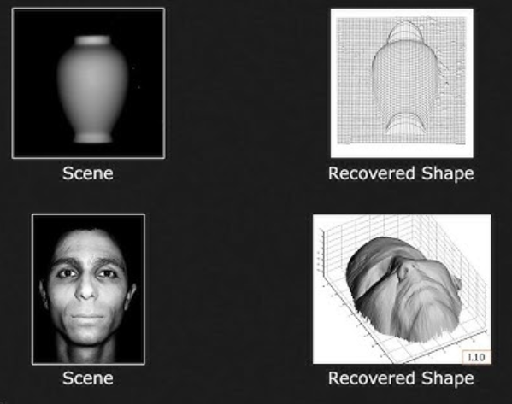
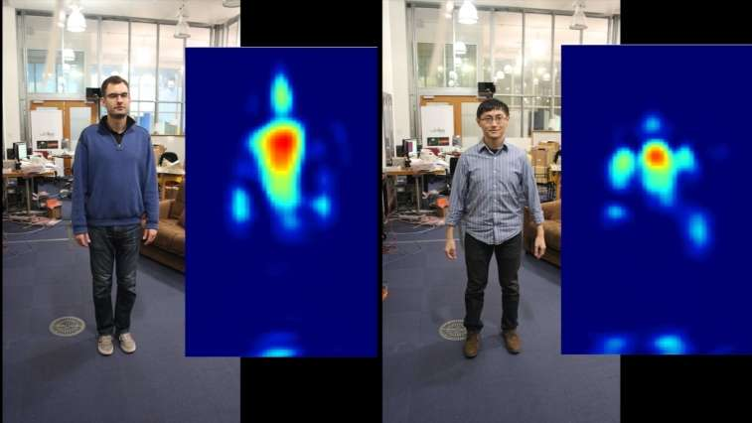
Introduction
Various methods of deriving three-dimensional shape information from two-dimensional images or data.

Slide 4
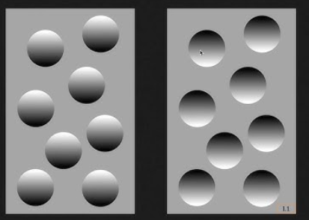
Why Attention?
"Existing techniques for extracting 3D information from 2D images are good, but not good enough,"
says Tianfu Wu, co-author of a paper on the work and an associate professor of electrical and computer engineering at North Carolina State

Slide 5
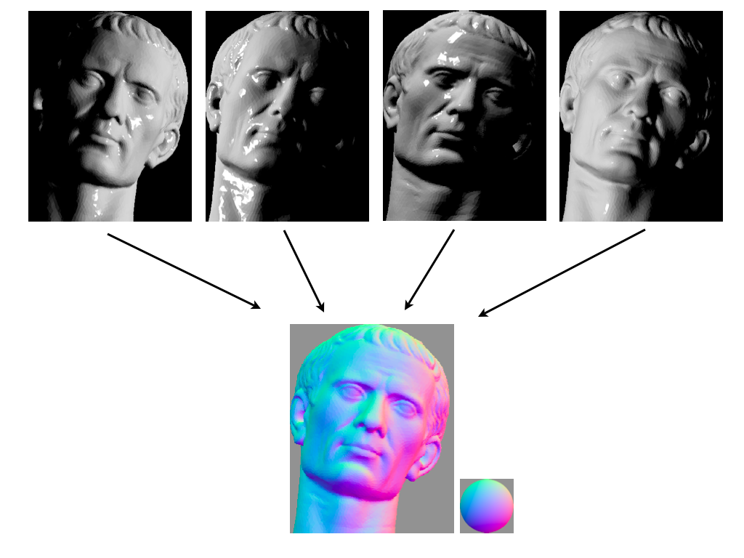
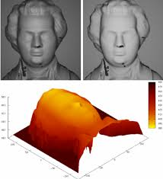
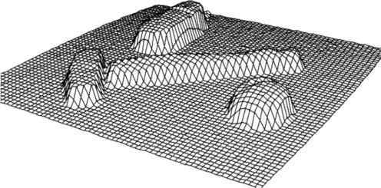
Shape from Shading
Determining the 3D shape of an object by analyzing the variations in brightness and shading in an image.
Explanatory diagram of photometric stereo. Multiple images of an object under different lighting are analyzed to produce an estimated normal direction at each pixel.

Slide 6
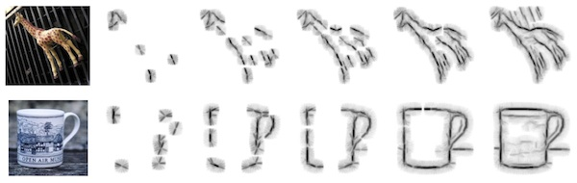
Shape from Contour
Reconstructing the 3D shape of an object by examining the edges and contours in an image.

Slide 7
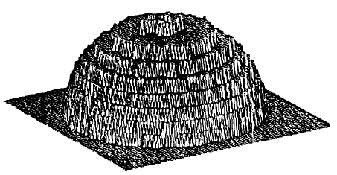
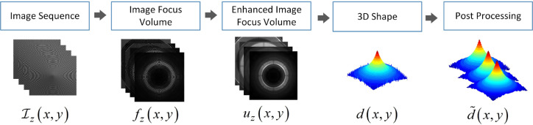
Shape from Focus (SfF)
Obtaining the 3D shape of an object by analyzing the variations in focus or depth of field in images.
Shape from focus or shape from defocus is a method of 3D reconstruction which consists of the use of information about the focus of an optical system to provide a means of measurement for 3D information. One of the simplest forms of this method can be found in most autofocus cameras today.

Slide 8
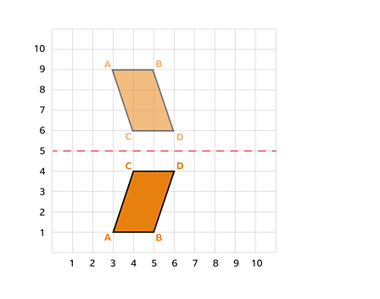
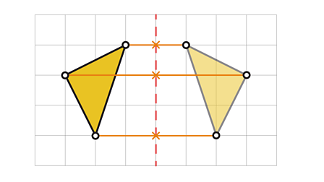
Shape from Reflection
Inferring the shape of an object by examining how it reflects light or other electromagnetic waves.

Slide 9
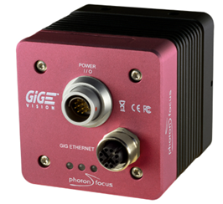
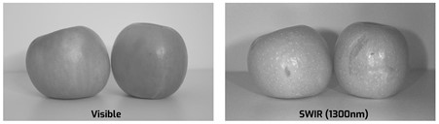
Shape from Infrared (SfIR)
Same as Shape from Reflection
Short-Wave Infrared (SWIR)
Where is usefull? Non-visible area.(for example in the night)
Problem: IR can make the object warmer … Link
SWIR Cameras from PhotonFocus

Slide 10
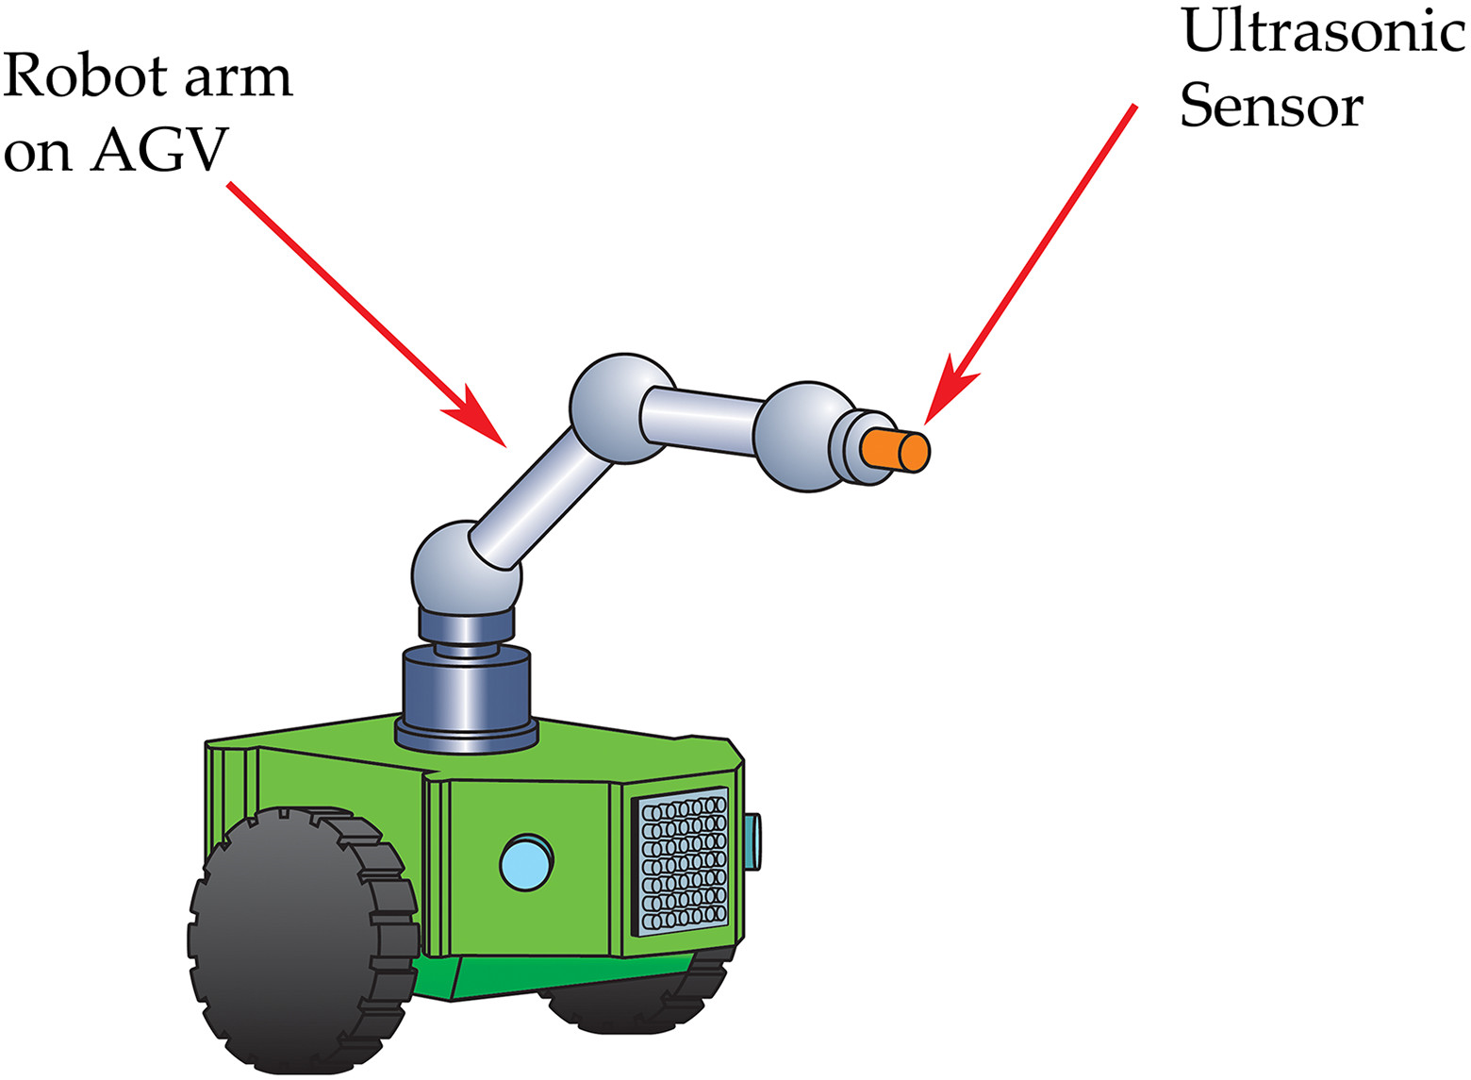
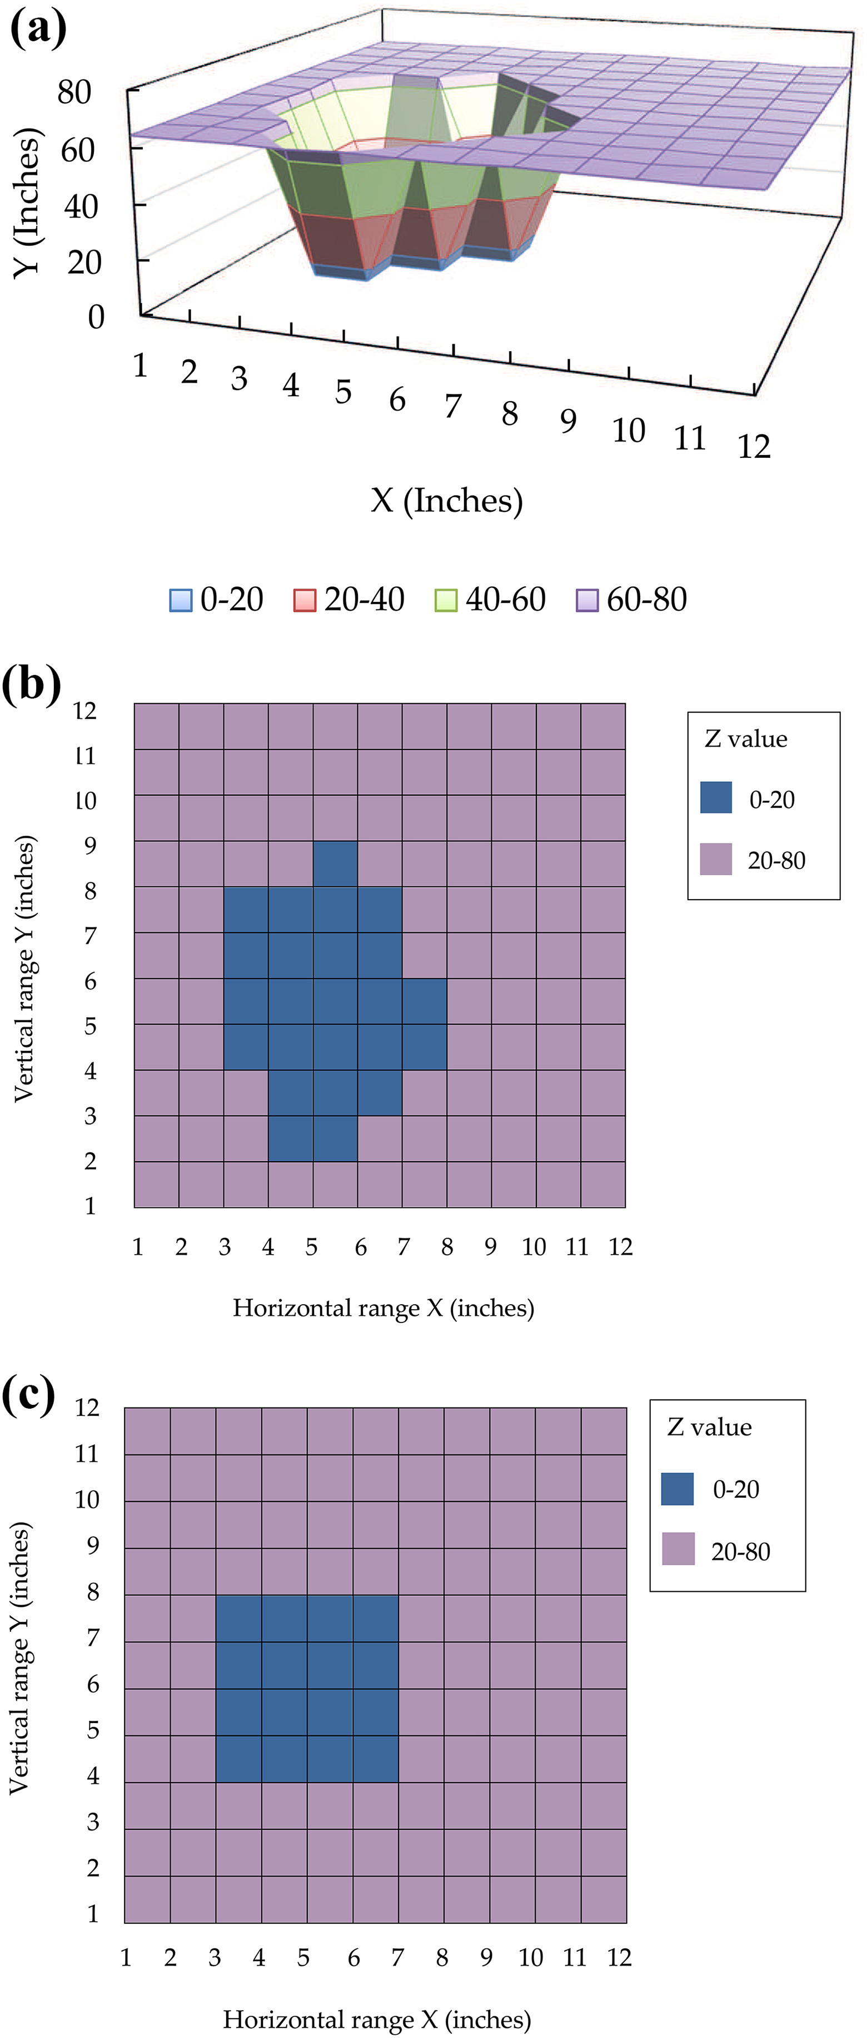
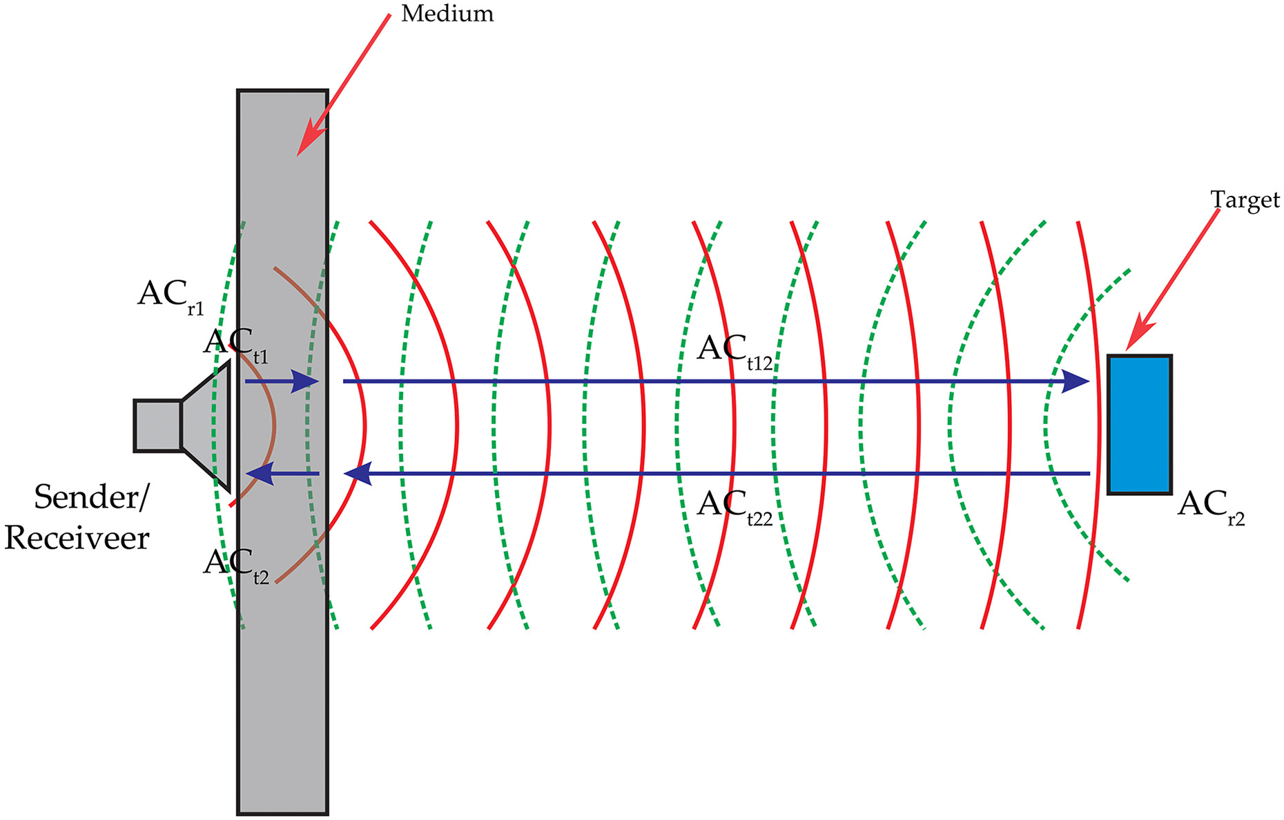
Shape from Sound (SfSd)
Estimating 3D shapes through the analysis of sound waves or echoes, often used in applications like sonar and echolocation.
Where is usefull? Non-visible area.(no light for example)

Slide 11
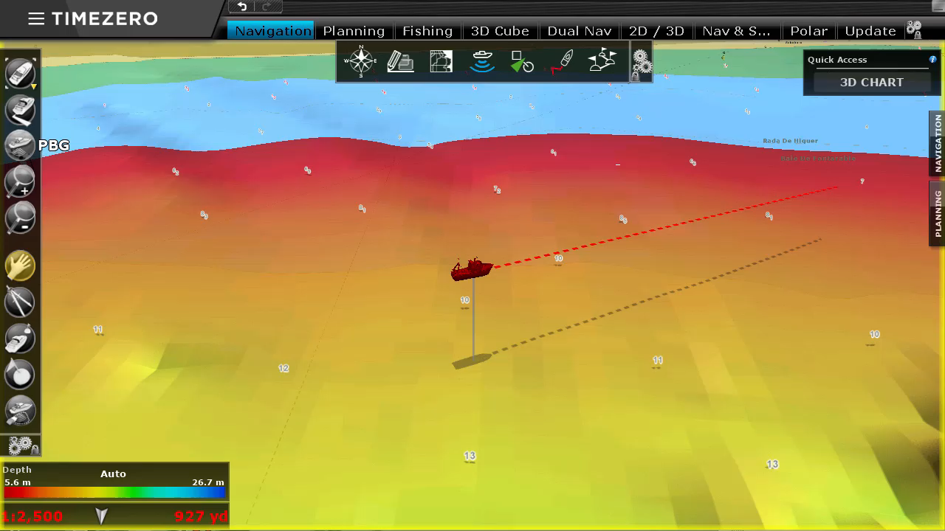
Shape from Sound (CONT…)

Slide 12
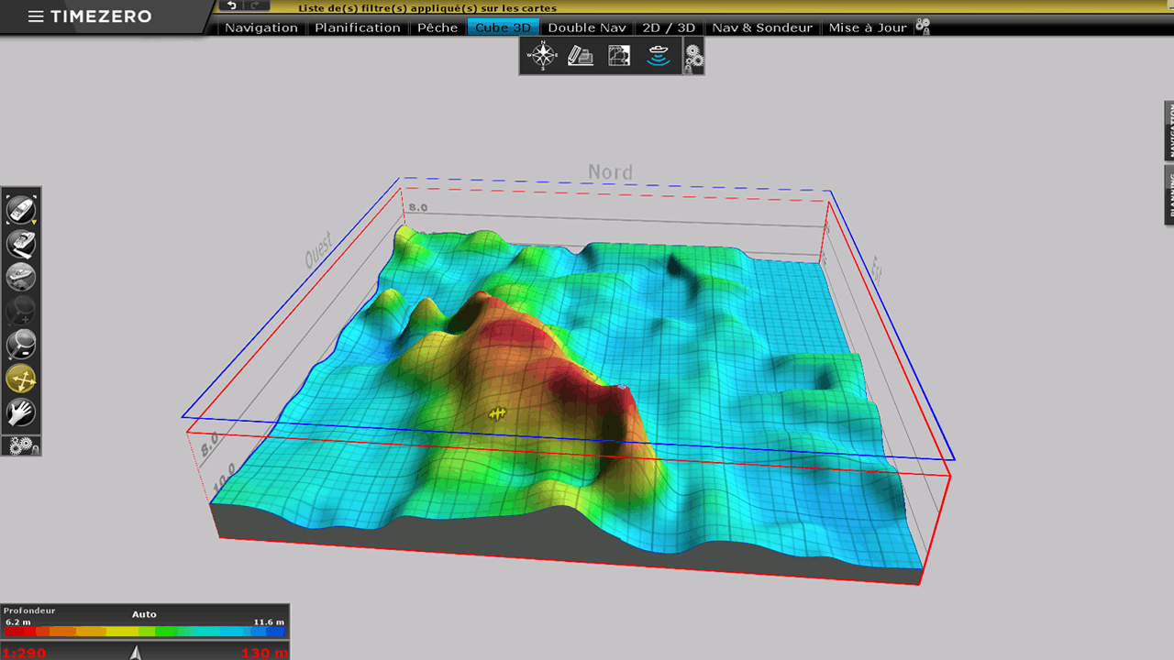

Slide 13
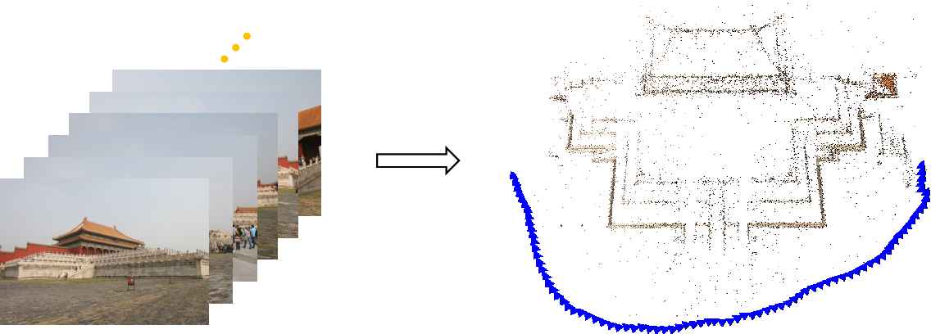
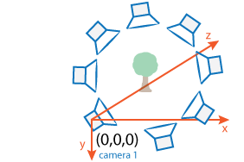
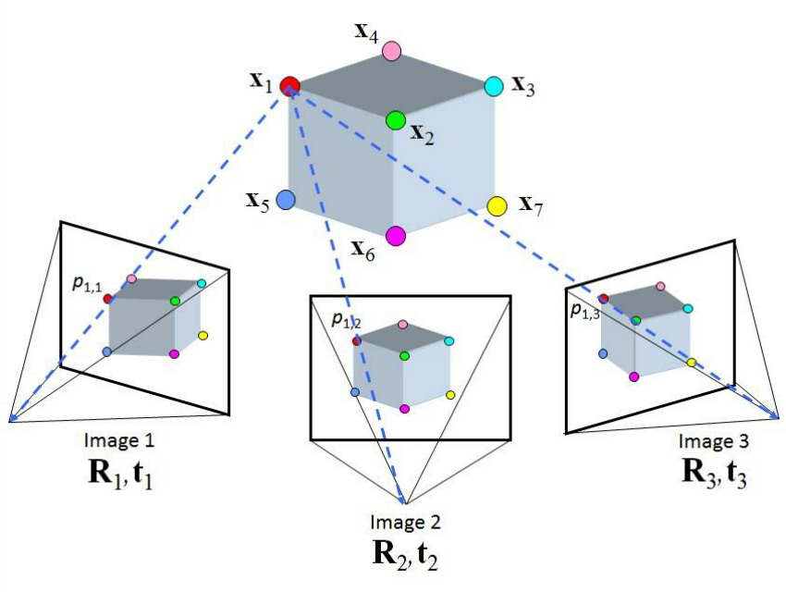
Shape from Motion
Inferring the three-dimensional shape of objects by tracking their movement or motion over time.

Slide 14
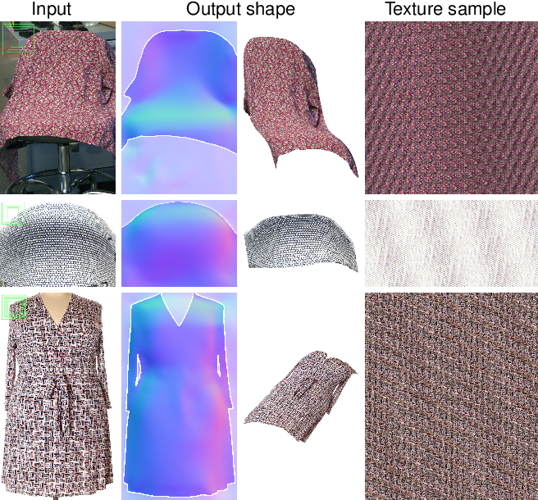
Shape from Texture
Estimating the 3D shape of an object by analyzing the patterns and texture in its surface.
In practice, implementing a complete SfT algorithm involves several complex steps, including camera calibration, dealing with different lighting conditions, and potentially using specialized libraries or custom code for depth integration.

Slide 15
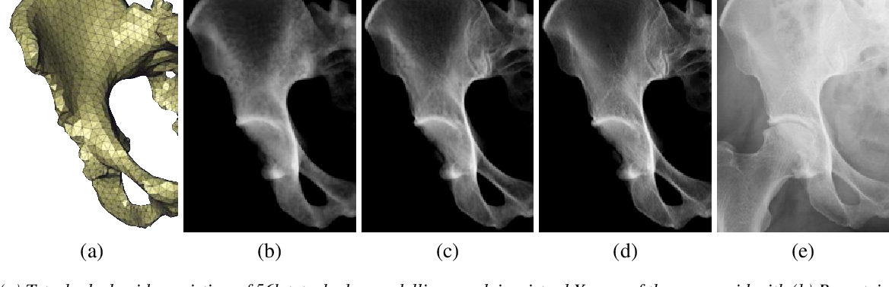
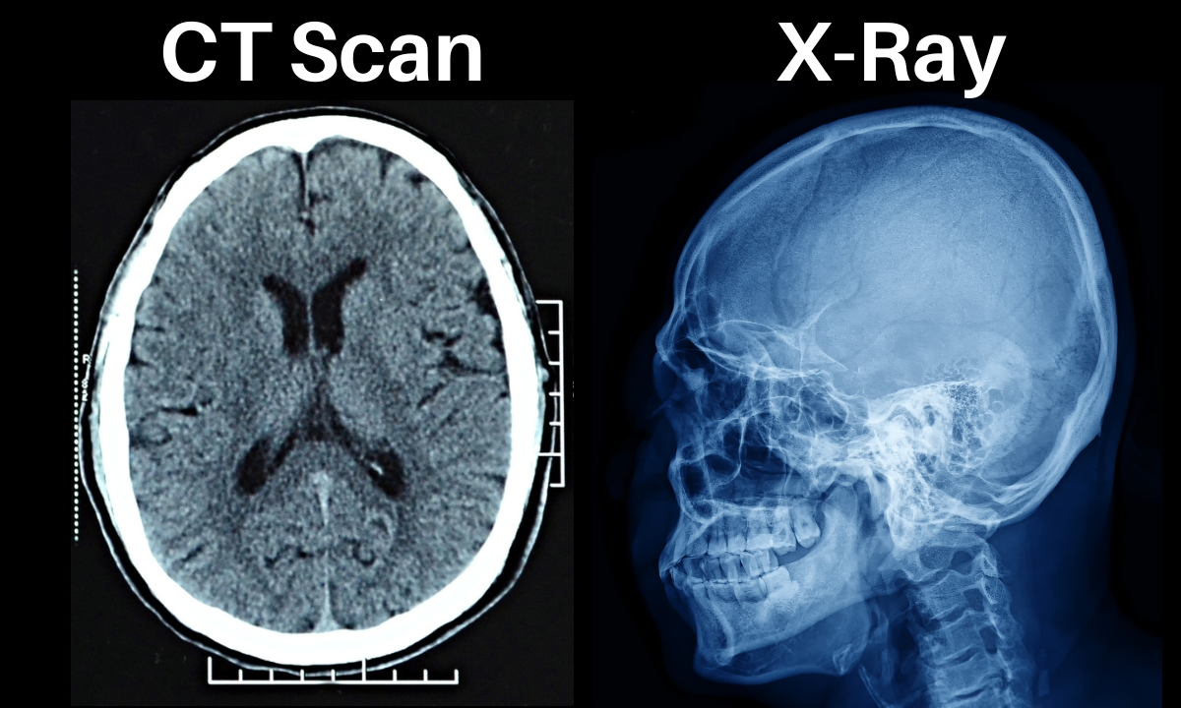
Shape from X-ray or CT Scan
Reconstructing the internal and external 3D structure of objects or organisms by using X-rays or computed tomography (CT) scans to analyze the attenuation of X-ray beams through the object.

Slide 16
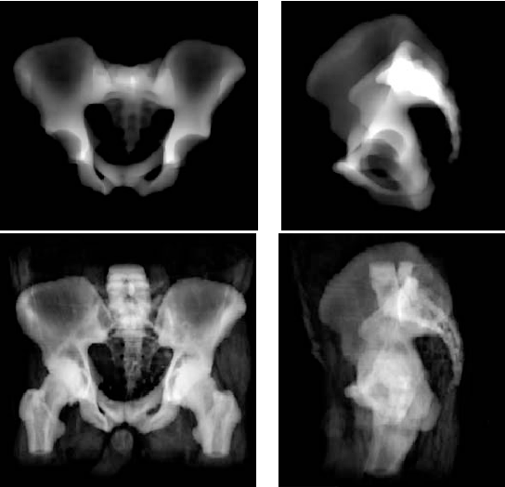
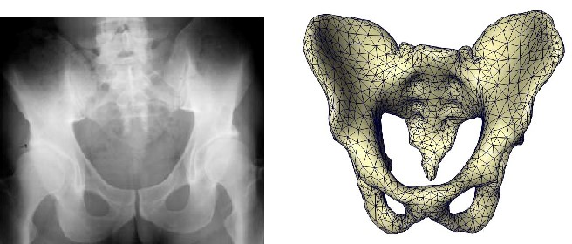
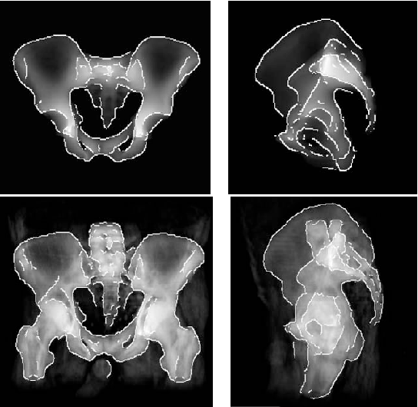
Shape from X-ray or CT Scan

Slide 17
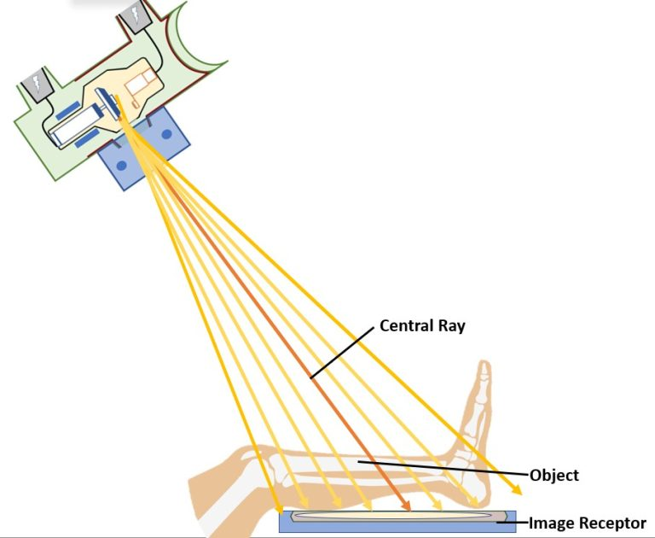
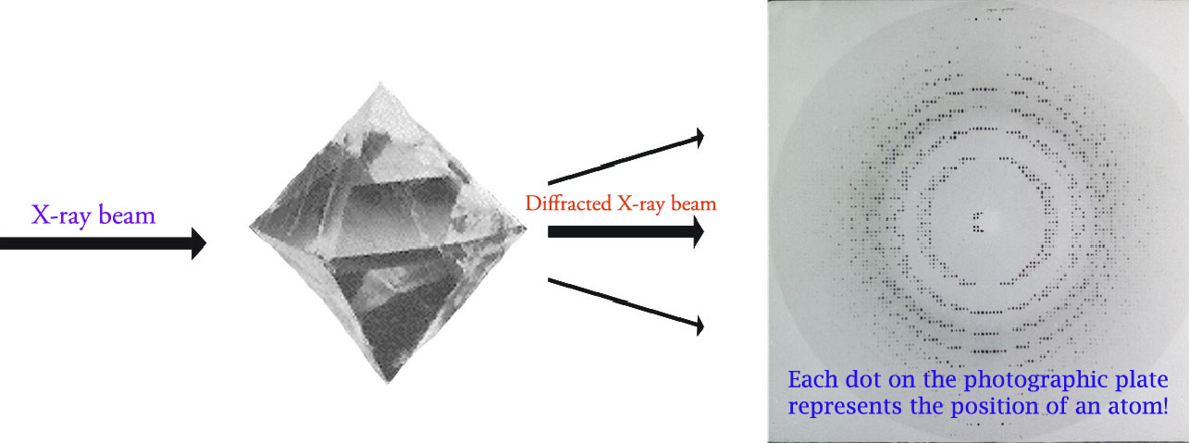
Shape from X-ray or CT Scan
https://www.cif.iastate.edu/sites/default/files/uploads/ACIDE/xrd1.jpg
XRD finds the geometry or shape of a molecule using X-rays. XRD techniques are based on the elastic scattering of X-rays from structures that have long range order. The X-rays get diffracted by a crystal because the wavelength of X-rays is similar to the inter-atomic spacing in the crystals.

Slide 18
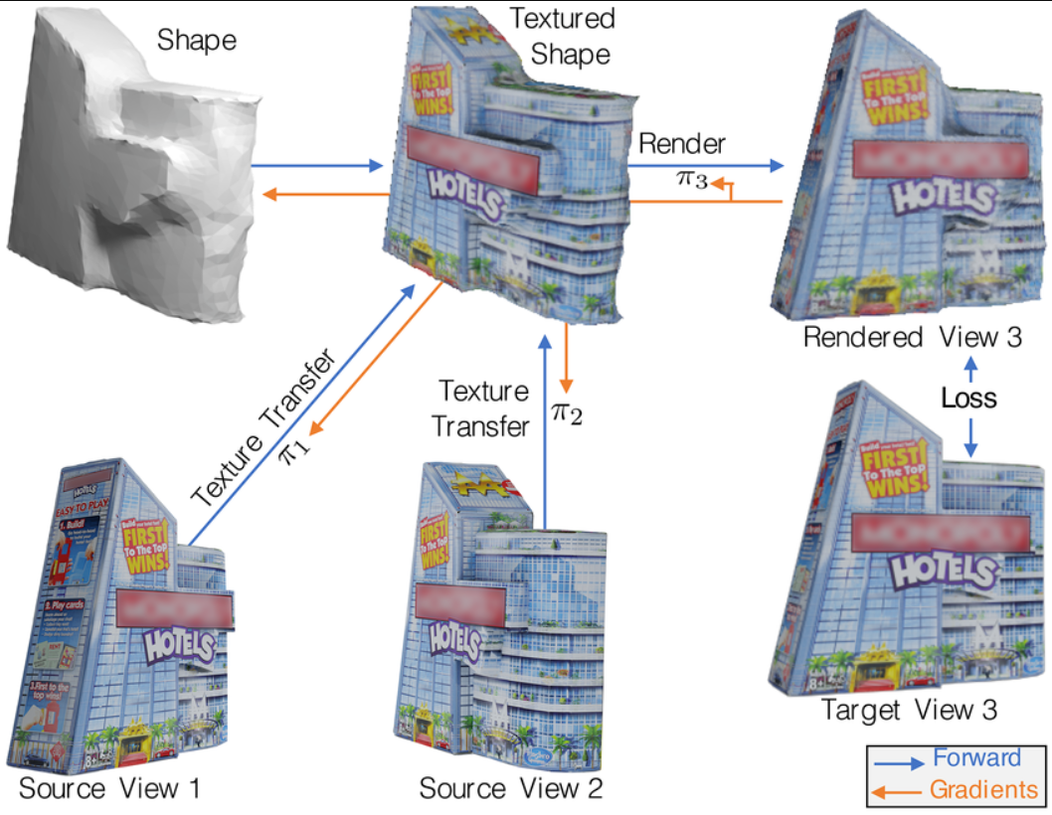
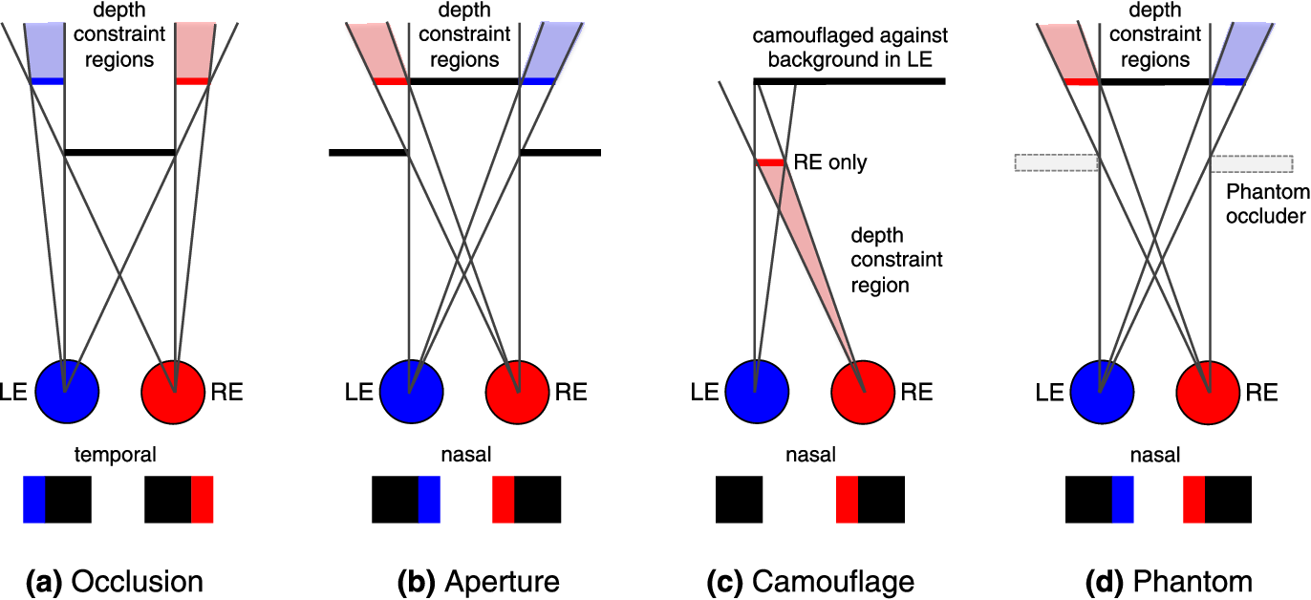
Shape from Stereopsis
Determining the 3D structure of objects by comparing the disparities or differences in the images seen by both eyes, which is the basis of human stereoscopic vision.
Check more info: HLink

Slide 19
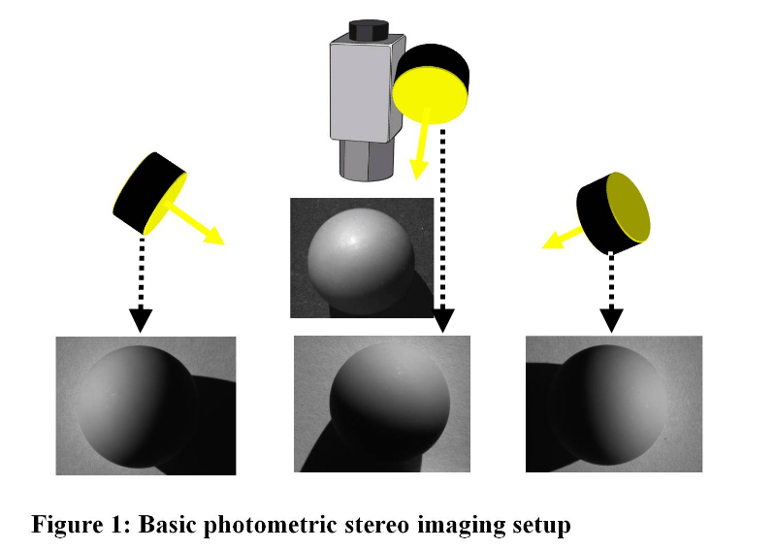
Photometric Stereo
A technique that calculates the surface normals and 3D shape of an object by capturing multiple images of the same object under different lighting conditions and analyzing how the object's appearance changes with varying lighting angles.

Slide 20
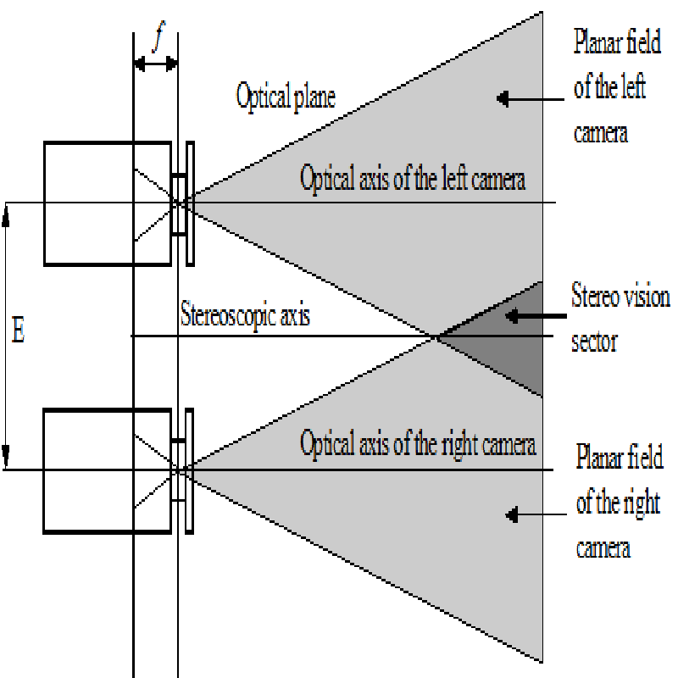
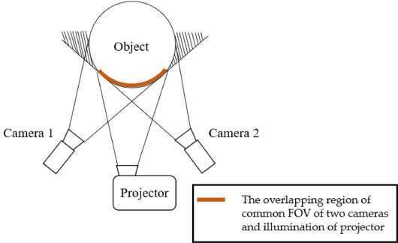
Stereo Idea

Slide 21
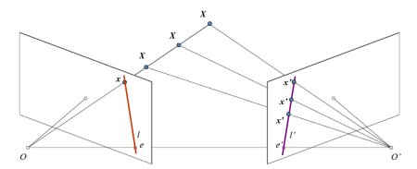
Epipolar Idea

Slide 22
Method | Pros | Cons | Applications
Shape from Shading | - Works with single images | - Sensitivity to lighting conditions | Robotics, surface inspection
Shape from Motion | - Can work in dynamic scenes | - Requires moving objects or camera | Motion tracking, 3D reconstruction
Shape from Texture | - Works well with textured surfaces | - Limited applicability on uniform surfaces | Object recognition, surface analysis
Shape from Contour | - Extracts detailed object boundaries | - Sensitive to noise and occlusions | Object recognition, edge detection
Shape from Focus | - Accurate depth estimation | - Requires multiple images with different focus settings | Microscopy, depth estimation
Shape from Stereopsis | - Provides accurate depth information | - Requires calibration and known camera parameters | 3D modeling, depth perception
Shape from Reflection | - Infers shape from specularities | - Limited applicability on non-reflective surfaces | Surface quality inspection, material analysis
Shape from Infrared | - Works in low-light or dark environments | - Limited details about surface characteristics | Night vision, surveillance
Shape from Sound | - Penetrates through obstacles | - Limited accuracy in complex environments | Echolocation, underwater mapping
Shape from X-ray/CT | - Reveals internal structure | - Radiation exposure, specialized equipment | Medical imaging, material analysis
Photometric Stereo | - Accurate surface normal estimation | - Requires controlled lighting conditions | Surface inspection, facial recognition

Slide 23
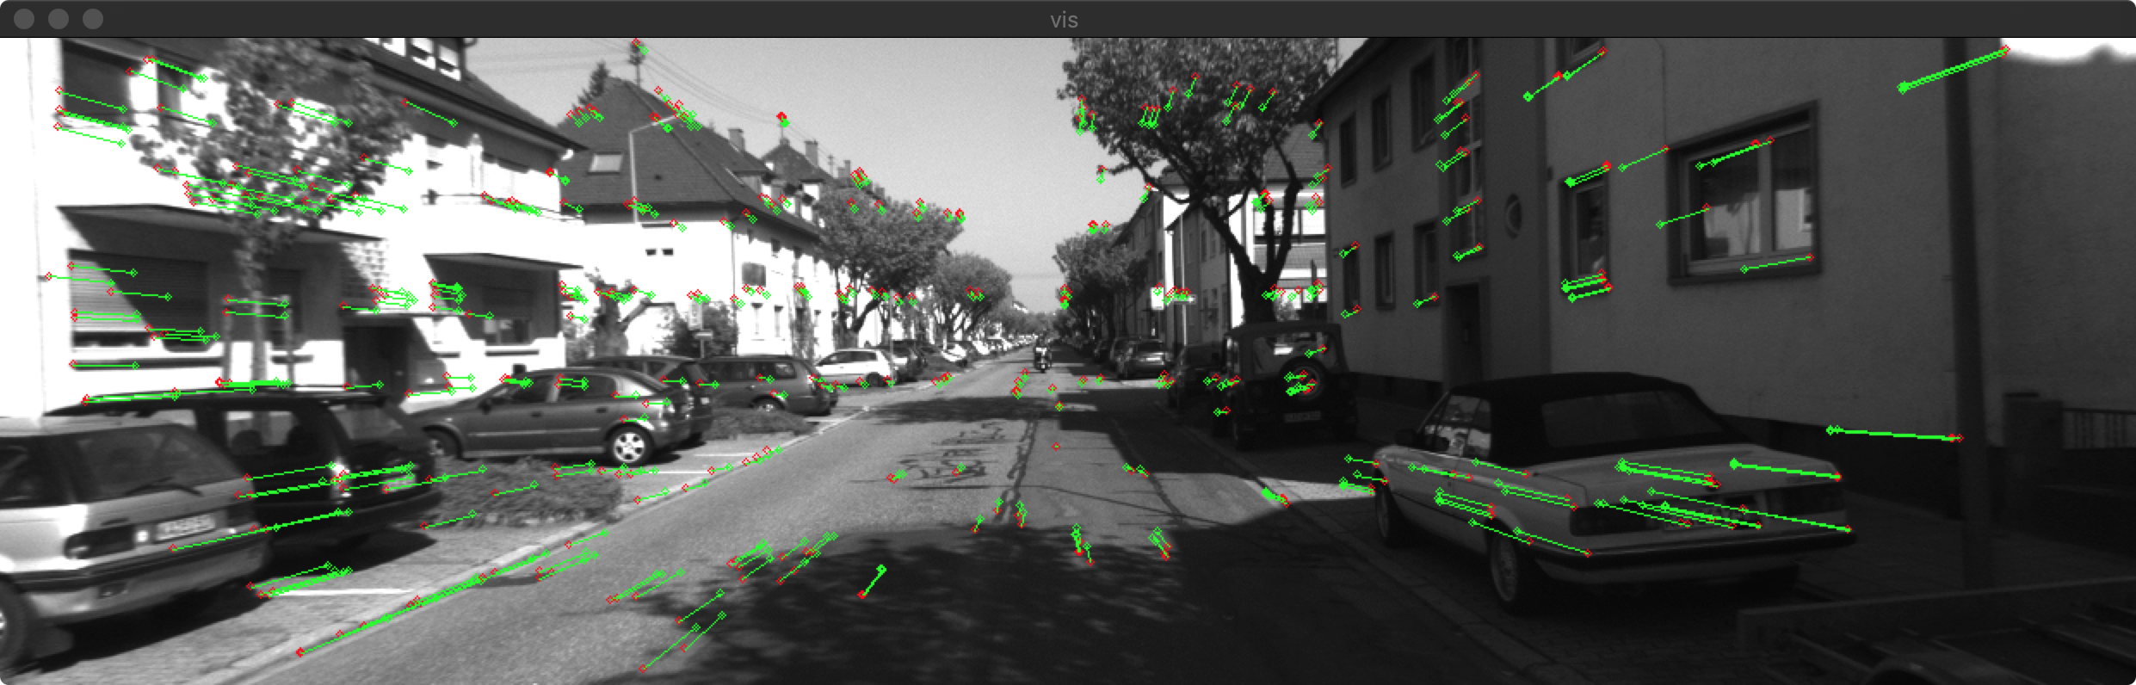
Applications of Shape from X
Autopilot (i.e:Tesla cars)
Sonars 3d reconstruction (i.e: fishing bussinness)
AR/VR , AR Games
Metaverse
Google earth
Automated guided vehicle
Medical Diagnosis
etc

Slide 24
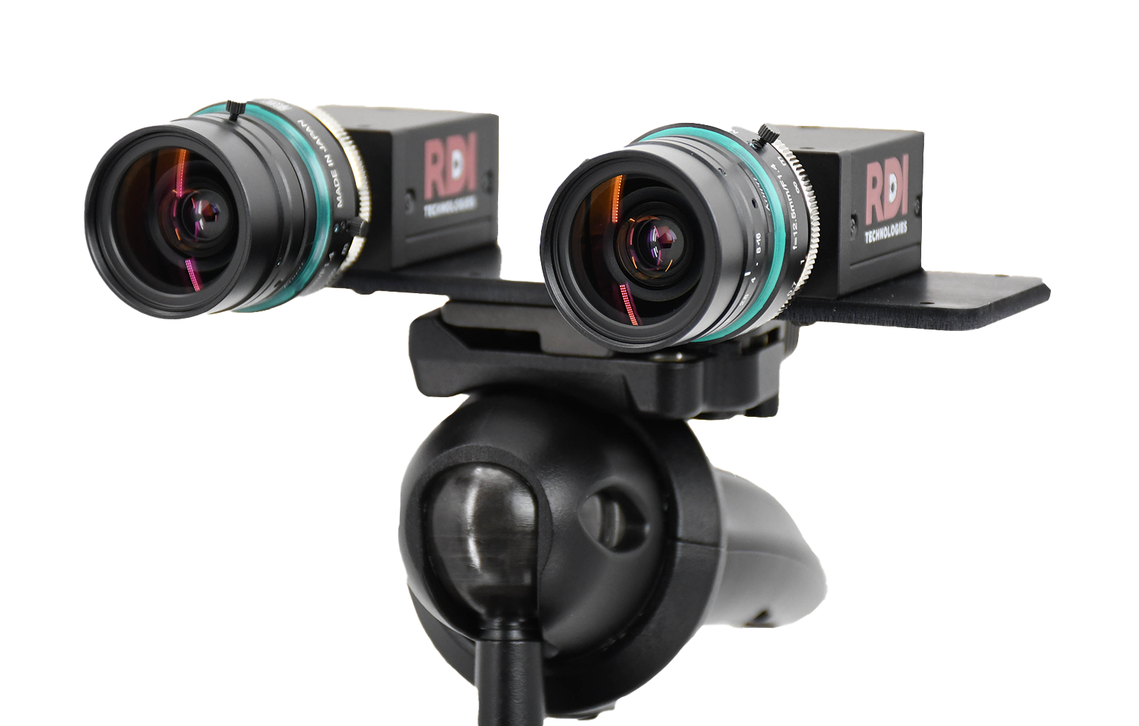
Estimation algorithms
Monocular Estimation → Single image
Stereo Estimation → multiple images

Slide 25
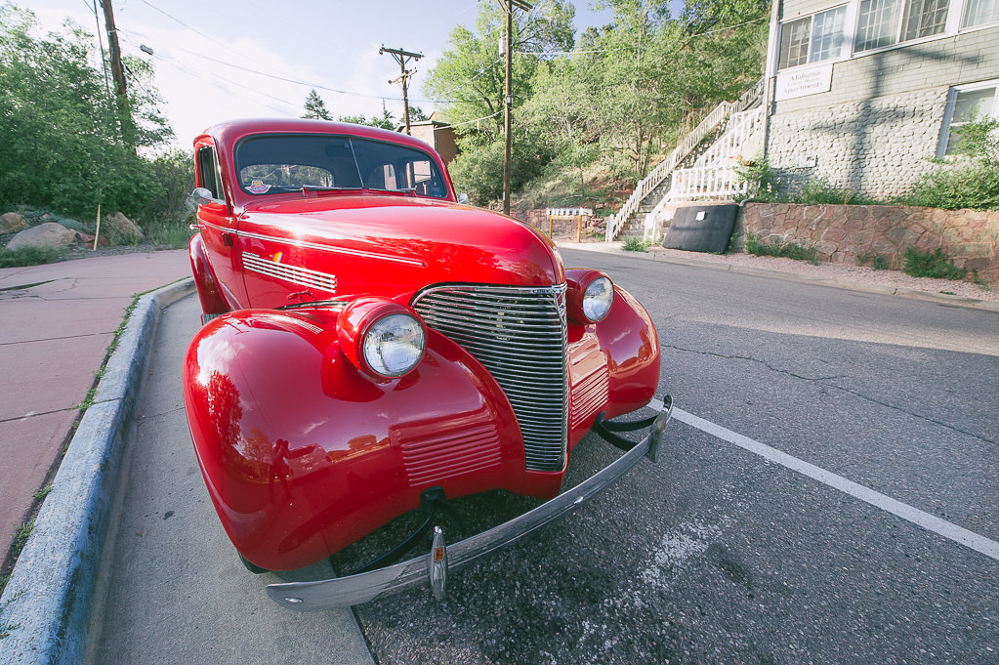
Camera distortion
All cameras has some distortion , so we can find these distortion by some methods or patterns.
We should assume some parameters for each camera! That does not just depend on the type of camera; it can also be caused by a so-long time using a camera or noise that was not present from the start.
Note: The cameras have more FOV and a wider area, which can be better for vision purposes(Wide-angle lenses and also Lens quality).

Slide 26


Camera matrix
Camera Extrinsic Matrix (World-to-Camera):
Converts points from world coordinate system to camera coordinate system. Depends on the position and orientation of the camera.
Camera Intrinsic Matrix (Camera-to-Image, Image-to-Pixel):
Converts points from the camera coordinate system to the pixel coordinate system. Depends on camera properties (such as focal length, pixel dimensions, resolution, etc.)

Slide 27
Commonly used coordinate systems in CV
https://towardsdatascience.com/what-are-intrinsic-and-extrinsic-camera-parameters-in-computer-vision-7071b72fb8ec

Slide 28
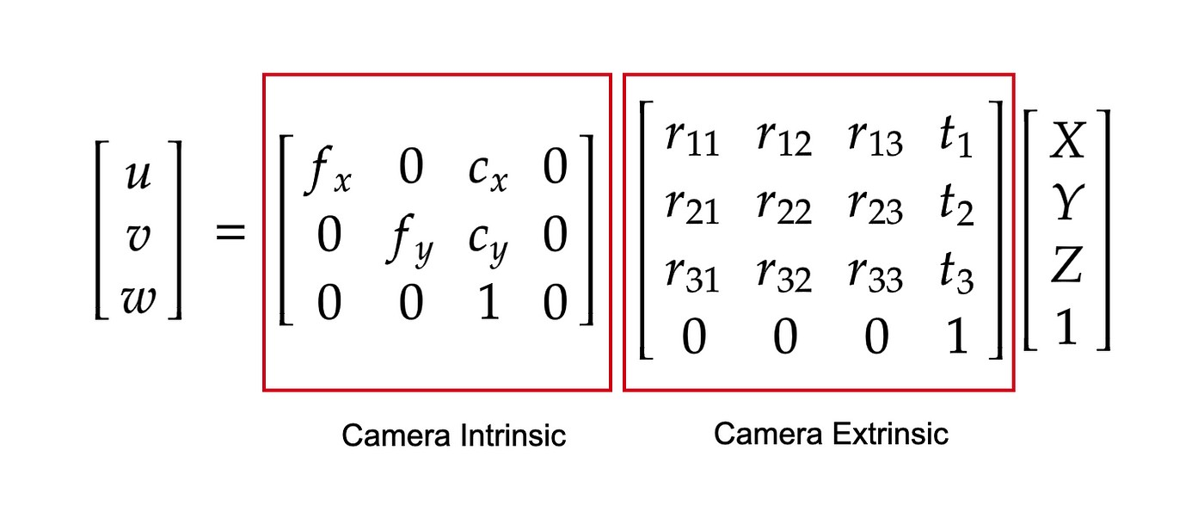
We need Intrinsic matrix(Camera matrix)
Image 2D
3D Coords

Slide 29
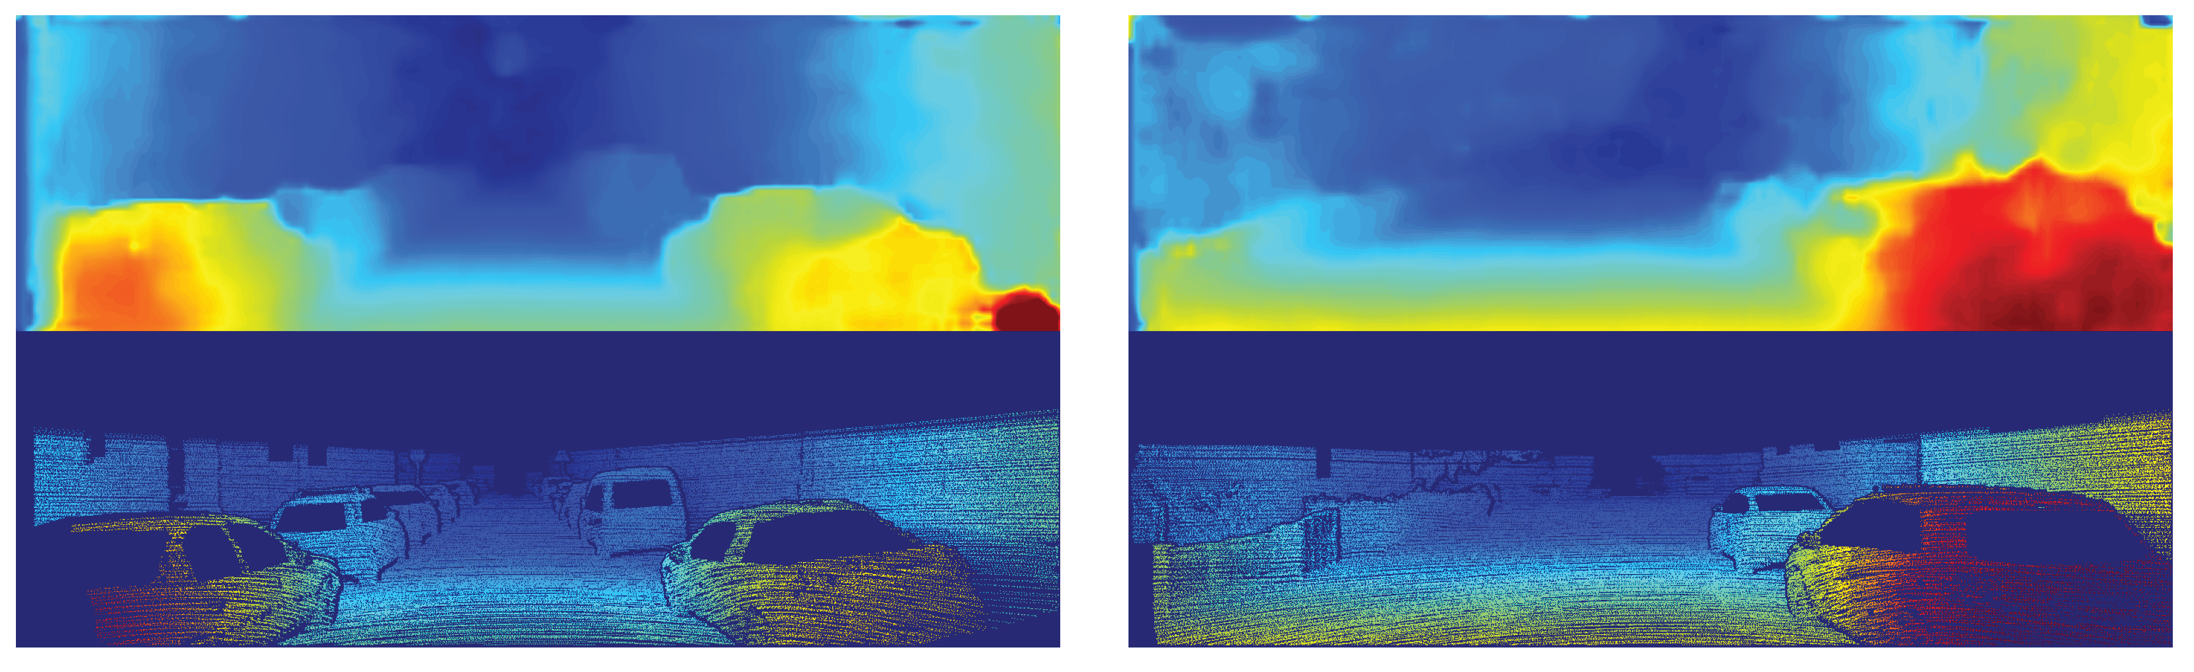
Stereo Estimation
Steps:
Camera Calibration(calc camera matrix)
Pose Estimation
Epipolar Geometry
Depth Map from Stereo Images

Slide 30
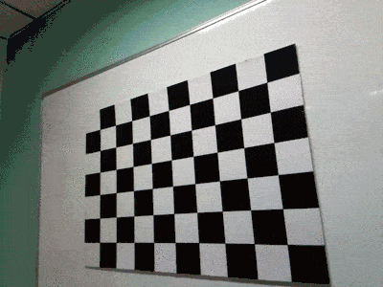
Calibration
Best test case can be checkers board.
Define real world coordinates with checkerboard pattern
Find checkerboard corners
Refine checkerboard corners
Calibrate Camera

Slide 31
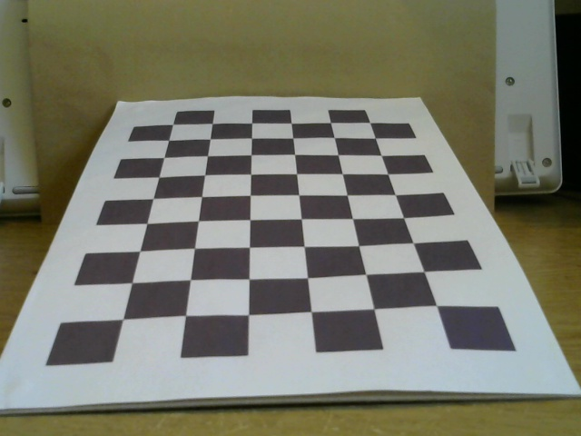
Original image

Slide 32
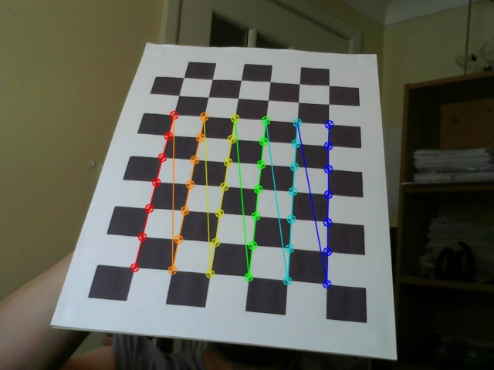
Calibration(cont…)

Slide 33
Pose Estimation
During the last session on camera calibration, you have found the camera matrix, distortion coefficients etc. Given a pattern image, we can utilize the above information to calculate its pose, or how the object is situated in space, like how it is rotated, how it is displaced etc.

Slide 34
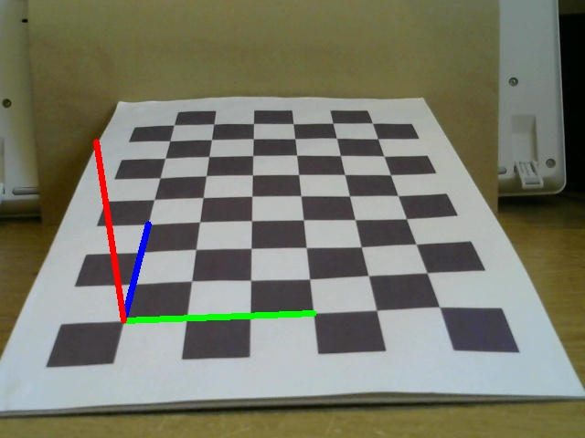
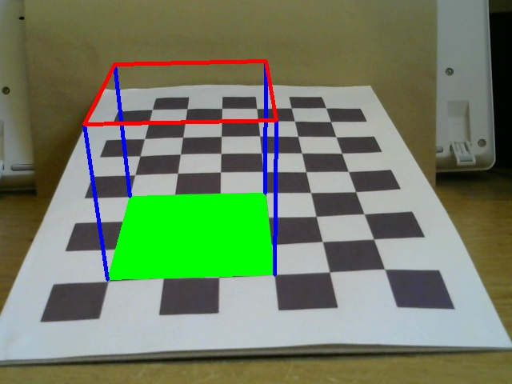
Pose Estimation(cont…)

Slide 36
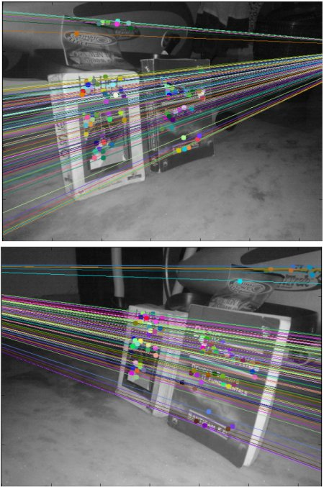
Epipolar Geometry
find as many possible matches between two images to find the fundamental matrix(use SIFT descriptors with FLANN based matcher and ratio test)
find the epilines(Epilines corresponding to the points in first image is drawn on second image)
L’: Epiline
Triangle: Epipolar plane
E: epipole

Slide 37
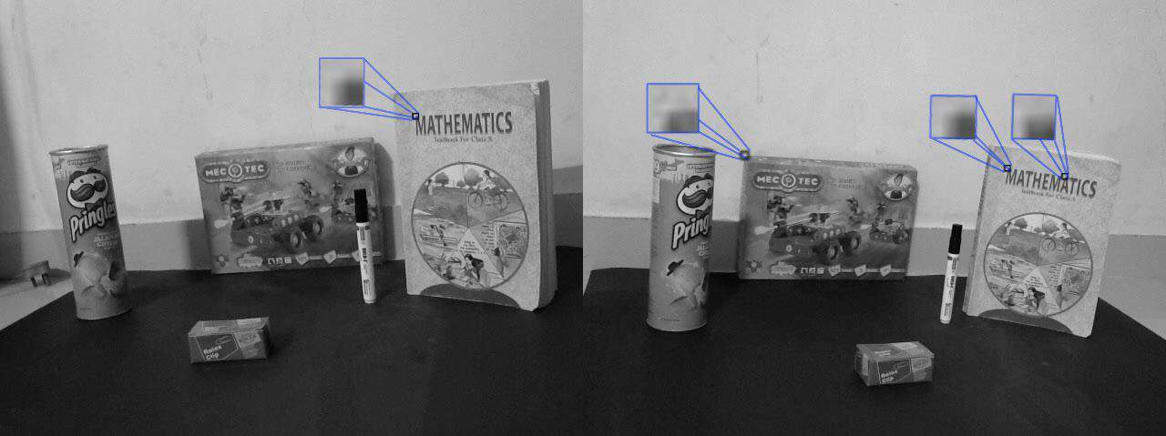
template matching
Multiple matched points using template matching.

Slide 38
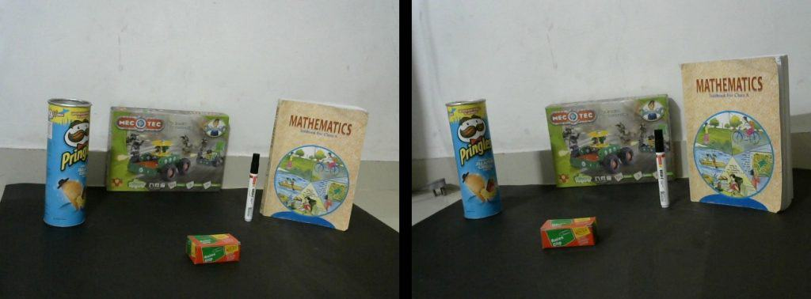
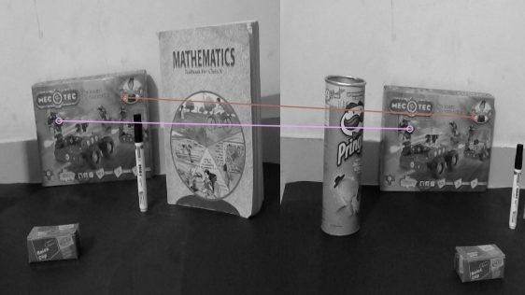
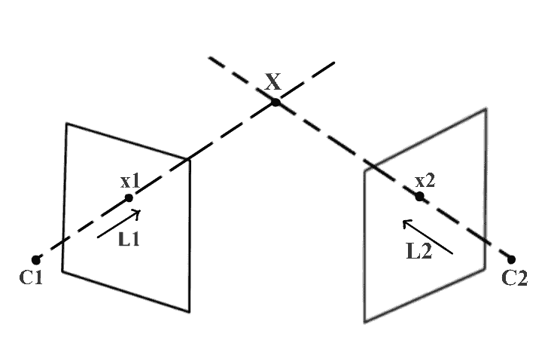
Photometric Stereo (Cont…)
Original images
Hand picked feature matches.

Slide 39

Photometric Stereo (Cont…)
Results of feature detection algorithm

Slide 40


Depth Map from Stereo Images

Slide 41

Result

Slide 42
monocular
one camera and using NN
RGB-D Camera and using some tricky ways!
This need a camera that has [depth + rgb]

Slide 43


Computer vision Kit
Sometime we just need a prepared kit to just use automatic features, for example:
OAK-D (OpenCV AI Kit- Depth) [can be used to help the computer perceive depth] too.
Motion estimation
Jpeg encoding
Feature tracking
Sematic segmentation
Object tracking in 3d space
Stereo depth

Slide 44


OAK-D (cont…)

Slide 45


OAK-D (cont…)
And more options!

Slide 46
Challenges and Future Directions
Sesors | cameras specs
Hardwares for computation
Diffrent situations
What can be used instead camera ?!
etc

Slide 47

360 degree images
Reconstruct 3d model from images in 360 degree

Slide 48

Points cloud to mesh

Slide 49
Final useful app [odometery]
https://github.com/ZhenghaoFei/visual_odom

Slide 50


Depth map from basic block matching

Slide 51

Camera calibration for kitti00 dataset’s
https://github.com/ZhenghaoFei/visual_odom/tree/master/calibration , example:
Camera.fx: 718.8560 # Camera calibration and distortion parameters
Camera.fy: 718.8560 # Camera calibration and distortion parameters
Camera.cx: 607.1928 # Camera calibration and distortion parameters
Camera.cy: 185.2157 # Camera calibration and distortion parameters
Camera.bf: -386.1448 # stereo baseline times fx
ThDepth: 35 # Close/Far threshold. Baseline times.
KITTI is a dataset for autonomous driving developed by the Karlsruhe Institute of Technology and Toyota Technological Institute at Chicago.

Slide 52

Deeper in the Topic
If you want to have more knowledge in this field, you can read this book:
Multiple View Geometry in Computer Vision
Or if you need good library to have better visualize in opencv, then use:
OpenCV Viz
Calib3d
It is good to take around 30 to 50 pictures with both cameras.

Slide 53
Useful links
The OpenCV calib3d library contains many useful functions for this process and Google is your friend for more details on how to apply them.
Also see: OpenCV with stereo 3D reconstruction, OpenCV 3D reconstruction using shipped images and examples
Lot of resource tutorials and stereo vision cameras:
http://www.intorobotics.com/fundamental-guide-for-stereo-vision-cameras-in-robotics-tutorials-and-resources/

Slide 54
More links
https://docs.opencv.org/2.4/modules/calib3d/doc/camera_calibration_and_3d_reconstruction.html
Nice general explain: https://stackoverflow.com/questions/64685185/is-there-a-way-to-generate-real-time-depthmap-from-single-camera-video-in-python
Create your calibration pattern: https://docs.opencv.org/3.4/da/d0d/tutorial_camera_calibration_pattern.html
Nice Example of the calibration: https://github.com/EveryWhereLab/camera-calibration-using-opencv-python
https://baptistehudyma.github.io/en/post/monocular_depth_map/
Good videos: https://cvg.cit.tum.de/research/vslam/lsdslam?redirect=1

Slide 55
good tutorial
https://gilscvblog.com/2014/05/15/an-easy-and-practical-guide-to-3d-reconstruction/
The procedure for building a 3D model is the following:
Take images of the object with your camera from multiple view points. The object should contain texture and shouldn’t have any transparent parts such as windows. Rotate around the object and take an image every few degrees. I used 51 images to create the reconstruction above.

Slide 56
references
https://learnopencv.com/
https://i.ytimg.com/vi/SLX7gPNHxSc/hq720.jpg?sqp=-oaymwEhCK4FEIIDSFryq4qpAxMIARUAAAAAGAElAADIQj0AgKJD&rs=AOn4CLCJaXEj2E8r8cfP_1ZYUsQxhO8jpQ
https://phys.org/news/2015-10-wireless-x-ray-vision-power-virtual.html
https://www.researchgate.net/figure/Shape-from-Shading-on-the-Mozart-face-Top-Input-images-Phong-Oren-Nayar-Bottom_fig1_221118830
https://www.sciencedirect.com/topics/computer-science/shape-from-shading
https://www.semanticscholar.org/paper/Global-Structure-from-Motion-and-Its-Application-Cui/8cf2de5b4dba7feb2997ddec2296a2a876974572
https://www.researchgate.net/figure/Structure-from-Motion-SfM-process-is-illustrated-The-structure-in-the_fig2_269327935
https://www.mathworks.com/help/vision/ug/structure-from-motion.html
https://www.semanticscholar.org/paper/Toward-a-Universal-Model-for-Shape-From-Texture-Verbin-Zickler/b7c1f89b695070ab23b599a5f31a82ab745408d7
https://hci.iwr.uni-heidelberg.de/content/contour-based-object-detection
https://d3i71xaburhd42.cloudfront.net/b59e81bf7fa01675a62bf28b3e4651b3bb933927/2-Figure1-1.png
https://www.researchgate.net/figure/Overview-of-Differentiable-Stereopsis-DS-The-shape-estimate-is-textured-using-source_fig2_355186990
https://www.bbc.co.uk/bitesize/topics/z2dqrwx/articles/z99n2v4
https://www.clearview-imaging.com/en/blog/non-visible-imaging-short-wave-infrared-swir
https://journals.sagepub.com/doi/full/10.1177/1729881418764638
https://mytimezero.com/tz-professional/solution-for-commercial-fishing
https://www.semanticscholar.org/paper/Atlas-based-3D-Shape-Reconstruction-from-X-Ray-Lamecker-Wenckebach/fb77476daa307e282493bfebe289cd153828601d
https://kiranpetct.com/the-difference-between-ct-scan-and-x-ray/
https://www.cif.iastate.edu/sites/default/files/uploads/ACIDE/xrd1.jpg
https://multipix.com/supportblog/imaging-software-technique-photometric-stereo-explained/
https://pubmed.ncbi.nlm.nih.gov/1891823/
https://www.youtube.com/watch?app=desktop&v=BfdwTytaBYI

Slide 57
references
https://www.mathworks.com/discovery/stereo-vision.html
https://www.mdpi.com/1424-8220/20/11/3249
https://learnopencv.com/camera-calibration-using-opencv/
https://www.kickstarter.com/projects/opencv/opencv-ai-kit
https://www.ebay.com/itm/255287881140
https://baptistehudyma.github.io/en/post/monocular_depth_map/
https://agisoft.freshdesk.com/support/solutions/articles/31000155265-how-to-build-a-complete-360-degree-model-of-an-object
https://doc.cgal.org/latest/Poisson_surface_reconstruction_3/index.html#Chapter_Surface_Reconstruction_from_Point_Sets
https://docs.opencv.org/2.4/doc/tutorials/viz/table_of_content_viz/table_of_content_viz.html
https://www.amazon.com/Multiple-View-Geometry-Computer-Vision/dp/0521540518
https://stackoverflow.com/questions/64685185/is-there-a-way-to-generate-real-time-depthmap-from-single-camera-video-in-python

